Slide 1
MySQL Enhancement Proposal:
Range Type
Tabs vs. Spaces
Varsha Ragavendran
Nisha Sharma
Davood Anbarnam
Ayman Abualsunun
Anton Sitkovets
Glib Sitiugin
Kevin Arindaeng
Notes:
10 sec max

Slide 2
Overview
Introduction
Proposed Enhancement and Motivation
Approaches of realizing the new feature
Impacts on existing subsystems
Testing Plans
Effects of Concurrency
Benefits of Enhancement
Risks and Limitations
Conclusion
Lessons Learned
Notes:
Today we’ll first start off with a brief introduction, followed by describing to you, the proposed enhancement chosen by the team. We will present a couple of approaches to realize this new feature, outlining the advantages and disadvantages of each approach, and the rationale behind choosing a particular approach to implement this new feature. Next we take a look at subsystems that could be potentially impacted because of this new feature followed by plans for testing the impact of interactions between this new feature and others. We then will cover the architectural changes due to this new feature, followed by risks and limitations. Finally a short conclusion and lessons learned will be presented.

Slide 3
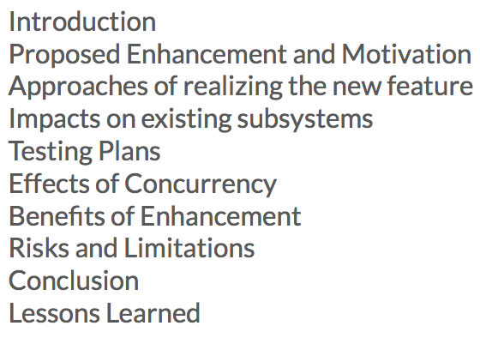
Introduction
Enhancing MySQL to support Range Types
allows users to set a range for each column within a table
Avoids using two columns to define start and end values of a range interval
Notes:
So our team chose to enhance MySQL by introducing Range Types on columns within a table. This feature allows users to set a defined range for each column on a table being created. This simple feature provides the solution to avoid having a table using multiple columns to define start and end values of a range interval, thereby reducing the number of columns in a table.

Slide 4
Proposed Enhancement and Motivation
Ranged Types: A data type that represents a range of values
• Reserving rooms
• Employee scheduling
• Buying something within a certain price range

Slide 5
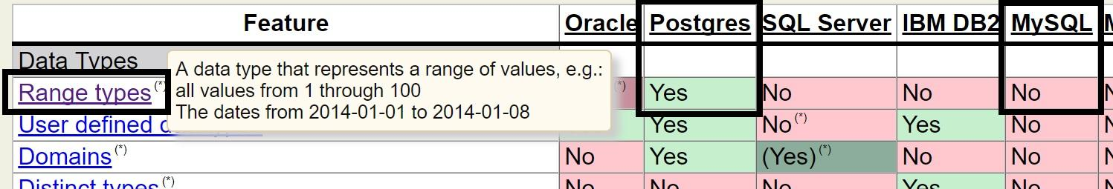
Proposed Enhancement and Motivation
http://www.sql-workbench.net/dbms_comparison.html

Slide 6
Proposed Enhancement and Motivation
MySQL Numeric and Date/Time Datatypes (Examples):
 | Integer | Fixed-Point | Floating Point | Date and Time
 | INT | DECIMAL(5,2) | FLOAT(5,3) | DATETIME
Example | 123456 | 999.99 | -999.999 | 1000-01-01 00:00:00

Slide 7
Proposed Enhancement and Motivation
MySQL Ranged Types (Examples):
 | Integer | Fixed-Point | Floating Point | Date and Time
 | INTRANGE | DECIMALRANGE(5,2) | FLOATRANGE(5,3) | DATETIMERANGE
Ex. | [100,200] | (500.01,900.99) | [-123.45,678.91) | [1000-01-01 00:00:00, 2017-11-29,13:00:00)
() = Does not include (exclusive)
[]= Includes (inclusive)

Slide 8
Proposed Enhancement and Motivation
CREATE TABLE work_sched ( employeeId INT ,during DATETIMERANGE );
INSERT INTO work_sched VALUES ( 1,
[2017-11-29 09:00:00, 2017-11-29,17:00:00] );

Slide 9
Proposed Enhancement and Motivation
SELECT * from work_sched where during =
‘[2017-11-29 09:00:00, 2017-11-29,17:00:00]’::DATETIMERANGE
SELECT * from work_sched where during <@
‘[2017-11-29 08:00:00, 2017-11-29,20:00:00]’::DATETIMERANGE
Where “<@” means “range is contained by”

Slide 10
Stakeholders
End-User
ORACLE
Competitors ( DB2, Amazon RDS)
Us

Slide 11
First Approach: Tuples
{ id1 ↦ e1, id2 ↦ e2, id3 ↦ e3, ... }
ei ≜ ith element of range
Id is generated, i.e. user does not provide one

Slide 12
Second Approach : Hybrid
[a, b] ≜ { x | a <= x <= b}
OR
{ id1 ↦ e1, id2 ↦ e2, id3 ↦ e3, ... }

Slide 13
Comparing the Approaches
Approach 1 - Tuples
General model
Relatively Simple
Large Ranges are an Issue (Scalability)
Approach 2 - Adaptive
Choice
Greater Efficiency with Intervals
More work on designer’s end
Final Choice : Approach 2

Slide 14
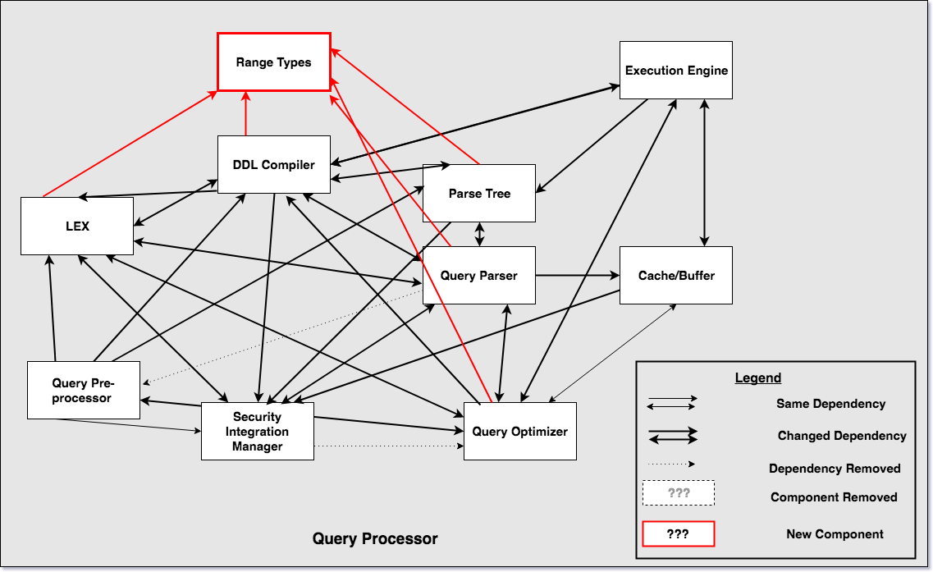
Impacts on subsystems

Slide 15
Plans for Testing
Compare the functional and nonfunctional test coverage
To account for: performance & resource utilization
Utilizing: Random Query Generator
Notes:
Our plans for testing include comparing the functional and non-functional test coverage between the existence and non-existence of the new feature. This will allow us to verify and account for the performance due to impact of interactions between the enhancement with other features. Utilizing RQG (random query generator) to perform concurrency tests and generating large number of SQL queries.
Functional requirements: describe the behavior/execution of the software system
Nonfunctional requirements: describe performance or usability of the software system
RQG is currently used by QA’s in Oracle working with MySQL

Slide 16
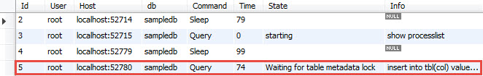
Effects of concurrency
No effect on concurrency control
MySQL supports locks of different granularities - row locks - table locks
Locks don’t deal with individual cells

Slide 17
Value/Benefits of Enhancement
Ranges are everywhere.
Many use cases that require ranges of values including price, scheduling and measurement data.
Implementing a range type reduces complexity of range value querying
Makes searching for overlapping data within a range much easier for the programmer
select '[2014/01/01, 2014/01/31]'::datetimerange;

Slide 18
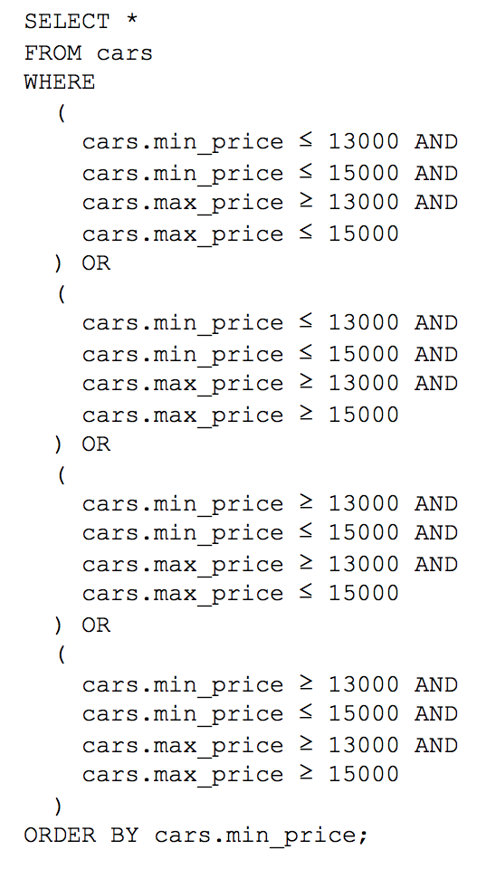
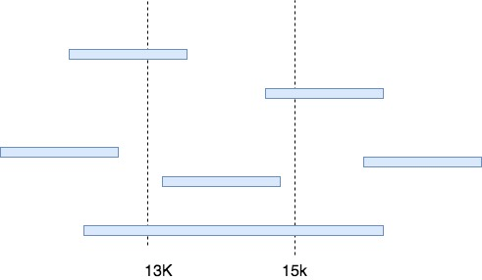
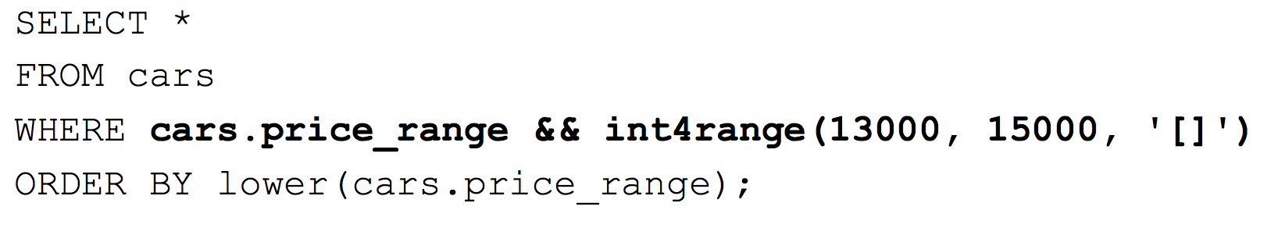
Value/Benefits of Enhancement Example
Shopping for a Used Car within a Min/Max budget
VS.

Slide 19
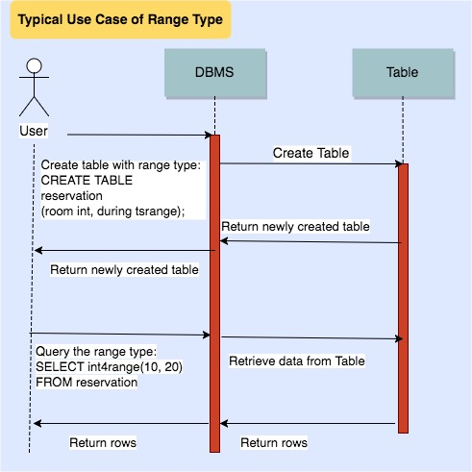
Use Cases

Slide 20
Risks and Limitations
Since a new subsystem is added there might be
some unexpected conflicts and overlapping with existing subsystems
Only limited to Numeric and DateTime data types
With others not so optimal
Notes:
The maximum number of tables that can be referenced in a single join is 61. This includes a join handled by merging derived tables (subqueries) and views in the FROM clause into the outer query block
once MySQL runs into the interval range it will not use any further index parts. If you have A BETWEEN 5 AND 10 AND B=5 for the same index MySQL will use the index… but it will only use A prefix for row lookups and scan whole A BETWEEN 5 AND 10 range.

Slide 21
Conclusions
Mysql with range types makes it easy to use.
Doable with the given second approach.
Doesn’t affect concurrency.
Minimal changes to other subsystems.

Slide 22

Lessons Learned
Normal MySQL
MySQL + Range Types

Slide 23
Question Period

